Slide 1
İNGİLİZCE THE FUTURE TENSE ( BE GOING TO )
THE SIMPLE FUTURE TENSE ( BE GOING TO )
( GELECEK ZAMAN ) ( BE GOING TO)

Slide 2
İNGİLİZCE THE FUTURE TENSE ( BE GOING TO )
Be going to gelecek zamanda olan bazı olayları ifade etmek için kullandığımız bir yapıdır.

Slide 3
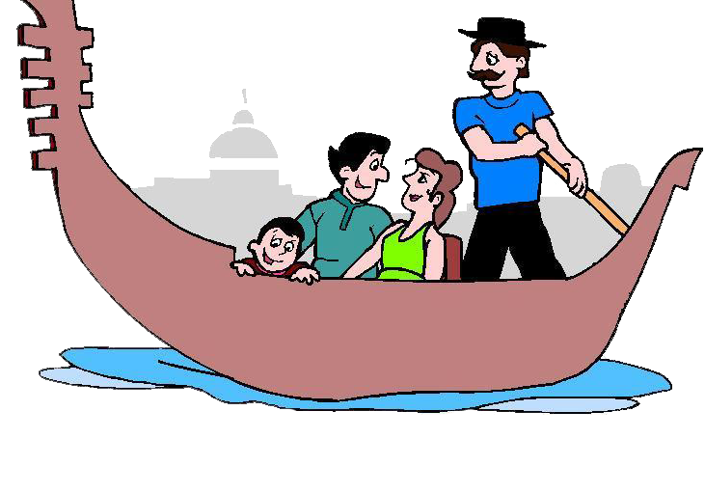
İNGİLİZCE THE FUTURE TENSE ( BE GOING TO )
Be Going To Nerelerde Kullanılır?
Önceden tasarlanmış, yapılmasına karar verilmiş eylemlerden bahsedilirken kullanılır.
I am going to go to Venice tomorrow.

Slide 4
İNGİLİZCE THE FUTURE TENSE ( BE GOING TO )
Be Going To Nerelerde Kullanılır?
Bir işin, olayın kaçınılmaz olduğunda veya bir olayla ilgili kanıtlarla, bilgilerle tahminde bulunulurken kullanılır.
She’s pregnant. She is going to have a baby next month.

Slide 5
İNGİLİZCE THE FUTURE TENSE ( BE GOING TO )
Be Going To Cümlede Nasıl Kullanılır?
Positive Sentences
I + am + going to + V1…
He / She / It + is + going to + v1…
You / We / They + are + going to + v1…

Slide 6
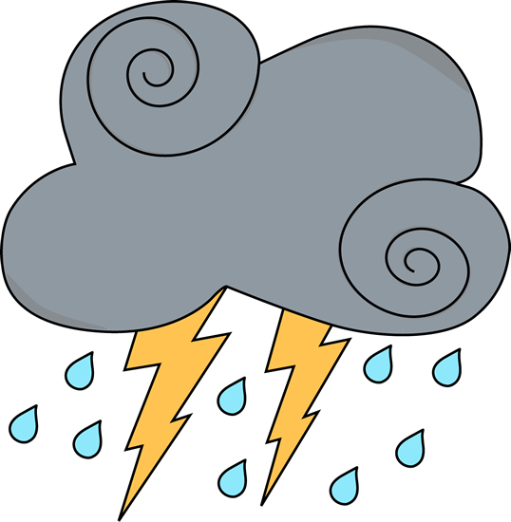
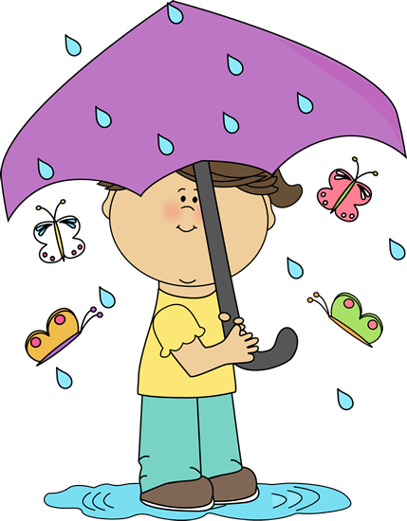
İNGİLİZCE THE FUTURE TENSE ( BE GOING TO )
EXAMPLES
Look at the clouds! It is going to rain.

Slide 7
İNGİLİZCE THE FUTURE TENSE ( BE GOING TO )
Negative Sentences
I + am not + going to + V1…
He / She / It + isn’t/is not + going to + v1…
You / We / They + aren’t/are not + going to + v1

Slide 8
İNGİLİZCE THE FUTURE TENSE ( BE GOING TO )
EXAMPLES
I am not going to talk him tomorrow.
I am really angry with him.

Slide 9
İNGİLİZCE THE FUTURE TENSE ( BE GOING TO )
Question Form
Am + I + going to + v1…?
Is + he/she/it + going to + v1….?
Are + you/we/they + going to + v1….?
Wh-, H- + am/is/are + subject + going to + v1..?

Slide 10
İNGİLİZCE THE FUTURE TENSE ( BE GOING TO )
EXAMPLES
What are your plans?
When are you going to start your new job?

Slide 11
İNGİLİZCE THE FUTURE TENSE ( BE GOING TO )
Will ile Going To Arasındaki Fark?
Going to ; önceden planlanmış işleri ve olma ihtimali yüksek olan olayları anlatmak için kullanılır.
Will ise aniden karar verilerek ya da emin olmadan yapılacak işleri anlatmak için kullanılan bir yapıdır. Ayrıca will; kişisel düşünceler, tahminler, evrensel varsayımlar, tehditler, verilen sözler, kesin kanıtı olmayan olaylardan da bahsederken kullanılabilen bir yapıdır.

Slide 12
İNGİLİZCE THE FUTURE TENSE ( BE GOING TO )
EXAMPLES
Dina is going to be successful. She always does her homework and listens to her teacher.

Slide 13
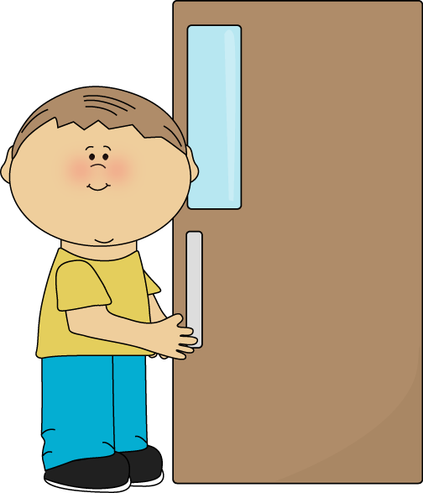
İNGİLİZCE THE FUTURE TENSE ( BE GOING TO )
EXAMPLES
George: Who will open the door, Martha?
Martha: In my opinion, Mark will open the door.

Slide 14
İNGİLİZCE THE FUTURE TENSE ( BE GOING TO )
EXAMPLES
My father is going to buy a new car
next Monday.

Slide 15
İNGİLİZCE THE FUTURE TENSE ( BE GOING TO )
EXERCISES
FILL IN THE BLANKS WITH WILL OR BE GOING TO
will
Fortune Teller: She ……. marry soon.
is going to
It is very cold. It …………….… snow.
are
going to
I know you have a ticket. When ….… you …….….... go?
4. I think, he ….…. invite you.
will
is not going to
5. He ………………..…… finish the project. He is very ill.

Slide 16
İNGİLİZCE THE FUTURE TENSE ( BE GOING TO )
THE SIMPLE FUTURE TENSE ( BE GOING TO )
( GELECEK ZAMAN ) ( BE GOING TO)

