Slide 1
İNGİLİZCE SOME EXPRESSIONS IN ENGLISH
SOME EXPRESSIONS IN ENGLISH

Slide 2
İNGİLİZCE SOME EXPRESSIONS IN ENGLISH
Strenghts
İngilizcede bazı durumlar karşısında söylenen bazı ifadeler vardır.
congratulations!: tebrikler!
well done!: aferin!
great idea!: harika bir fikir!
poor you!: yazık sana!
what a pity!: ne yazık!
how horrible!: ne korkunç!
good heavens: aman Allahım!
what a shame!: Ne ayıp!
hard luck!: şansa bak! şanssızlık!

Slide 3
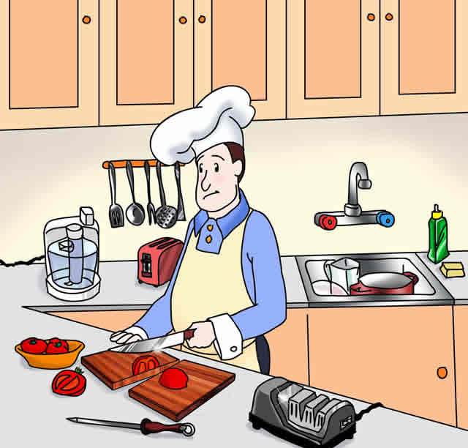
İNGİLİZCE SOME EXPRESSIONS IN ENGLISH
EXAMPLES
- I cut my finger while I was making salad.
- Poor you!

Slide 4
İNGİLİZCE SOME EXPRESSIONS IN ENGLISH
EXAMPLES
- He shouted at me in front of the people.
- What a shame!

Slide 5
İNGİLİZCE SOME EXPRESSIONS IN ENGLISH
EXAMPLES
- Tom has broken his leg.
- How awful!

Slide 6
İNGİLİZCE SOME EXPRESSIONS IN ENGLISH
EXAMPLES
- I have lost my wallet.
- What a pity!

Slide 7
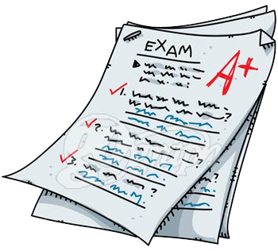
İNGİLİZCE SOME EXPRESSIONS IN ENGLISH
EXAMPLES
- I passed the exam yesterday.
- Well done!

Slide 8
İNGİLİZCE SOME EXPRESSIONS IN ENGLISH
EXAMPLES
- I have won the race.
- Congratulations!

Slide 9
İNGİLİZCE SOME EXPRESSIONS IN ENGLISH
SOME EXPRESSIONS IN ENGLISH

