Slide 1
İNGİLİZCE APPEARANCE AND PERSONALITY
APPEARANCE AND PERSONALITY
(GÖRÜNÜŞ VE KİŞİLİK)

Slide 2
İNGİLİZCE APPEARANCE AND PERSONALITY
İnsanların dış görünümünden ve karakterlerinden bahsederken kullanılan ifadeleri öğrendik. Bu dersimizde bunlarla ilgili çalışmalar yapacağız.

Slide 3
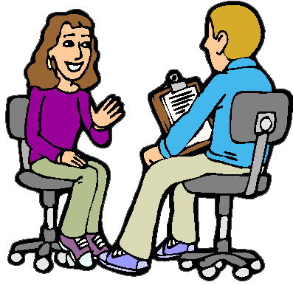
İNGİLİZCE APPEARANCE AND PERSONALITY
Who is your favorite
actor?
My favorite actor is
Will Smith.

Slide 4
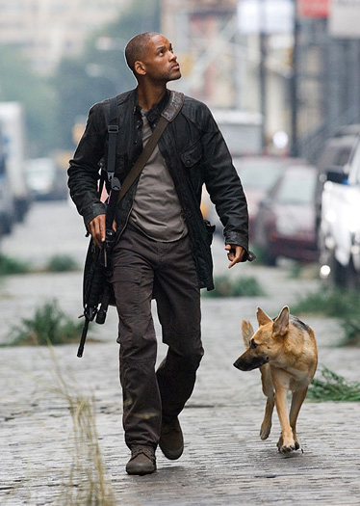
İNGİLİZCE APPEARANCE AND PERSONALITY
He is handsome with his dark hair and black eyes. He is tall and slim. He is well-built.
What does Will Smith look like?

Slide 5
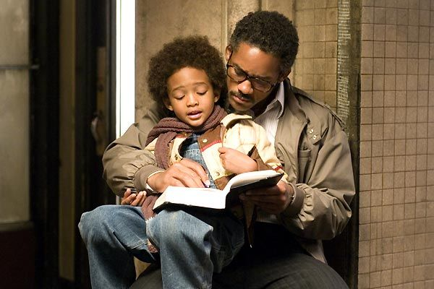
İNGİLİZCE APPEARANCE AND PERSONALITY
What is Will Smith’s role like in the Pursuit of Happyness film?
He is hardworking and helpful.

Slide 6
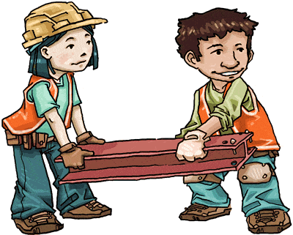
İNGİLİZCE MAKING COMPARISIONS
EXERCISES
Choose the correct answer
friendly
1- She gets on well with her friends. She is …………...
a) friendly b) clumsy c) tall d) lazy
2- Tom usually breaks something. He is …………..
clumsy
a) easy going b) outgoing c) sociable d) clumsy
3- Elena usually can’t remember addresses and appointments.
She is …………...
forgetful
a) talkative b) forgetful c) generous d) selfish
helpful
4- Martin is ………….
a) helpful b) stingy c) messy d) bossy

Slide 7
İNGİLİZCE APPEARANCE AND PERSONALITY
APPEARANCE AND PERSONALITY
(GÖRÜNÜŞ VE KİŞİLİK)

