Slide 1
İNGİLİZCE SIMPLE PRESENT TENSE – QUESTION FORM
SIMPLE PRESENT TENSE – QUESTION FORM

Slide 2
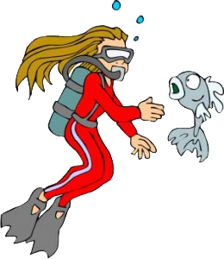
İNGİLİZCE SIMPLE PRESENT TENSE – QUESTION FORM
Do you like scuba-diving?
I am crazy about scuba-diving.

Slide 3
İNGİLİZCE SIMPLE PRESENT TENSE – QUESTION FORM
Does he read a book every night?
No, he doesn’t.
He seldom reads a book.

Slide 4
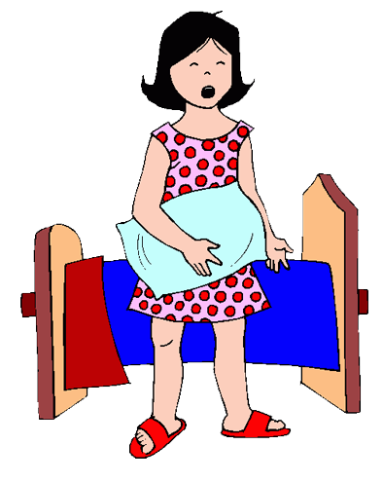
İNGİLİZCE SIMPLE PRESENT TENSE – QUESTION FORM
What time does Taylor get up?
She gets up at 8 o’clock.

Slide 5
İNGİLİZCE SIMPLE PRESENT TENSE – NEGATIVE SENTENCES
Geniş zamanda soru sorarken do ve does yardımcı fiillerinden yararlanırız.
Az önceki örneklerde de görüldüğü gibi:
Do + I / You / We / They + v1 ….?
Does + he / she / it + v1 ………?
Wh-, H- + do / does + subject + v1…..?

Slide 6
İNGİLİZCE SIMPLE PRESENT TENSE – QUESTION FORM
Do they speak French?
No, they don’t speak French.

Slide 7
İNGİLİZCE SIMPLE PRESENT TENSE – QUESTION FORM
Does Kate study everyday?
Yes, she studies everyday.

Slide 8
İNGİLİZCE SIMPLE PRESENT TENSE – QUESTION FORM
What do you do after
school?
I play volleyball.

Slide 9
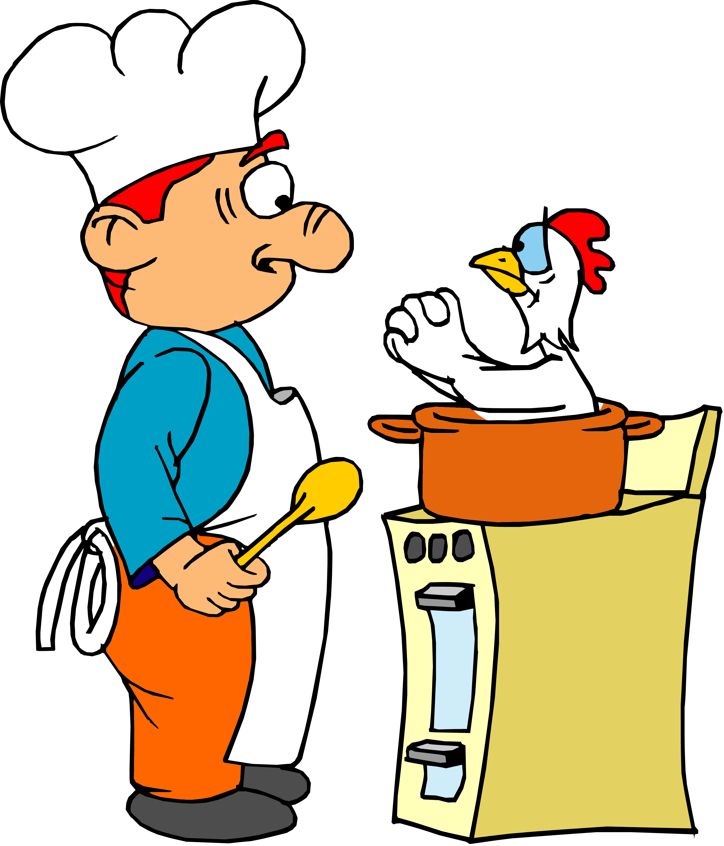
İNGİLİZCE SIMPLE PRESENT TENSE – QUESTION FORM
How often does your father prepare meal?
He never prepares meal.

Slide 10
İNGİLİZCE SIMPLE PRESENT TENSE – QUESTION FORM
EXERCISES
1 - .............................. ?
Where do you live
I live in Poland.
What does she have for breakfast
2 - ..................................................... ?
She has cheese, tomatoes, bread for breakfast.
Does he like horse riding
3 - ....................................... ?
No, he can’t stand horse riding.
How often do you visit your grandfather
4 - ................................................................. ?
We visit our grandfather three times a year.

Slide 11
İNGİLİZCE SIMPLE PRESENT TENSE – QUESTION FORM
SIMPLE PRESENT TENSE –QUESTION FORM

